Slide 1
JavaScript Day3
JS
Presented By : Asmaa Ahmed

Slide 2


Regular Expression
Regular expressions, often referred to as regex or regexp, are powerful tools used for pattern matching and manipulation of text. They provide a concise and flexible means to search, extract, and replace specific patterns within strings.
In JavaScript, regular expressions are represented by the RegExp object. There are two ways to create a RegExp object: using the literal syntax or using the RegExp constructor function.
1-Literal Syntax:
2-RegExp Constructor:

Slide 3
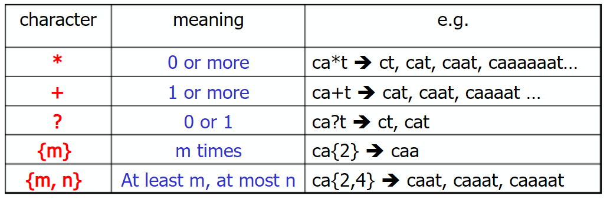
some commonly used metacharacters and their meanings:

Slide 4
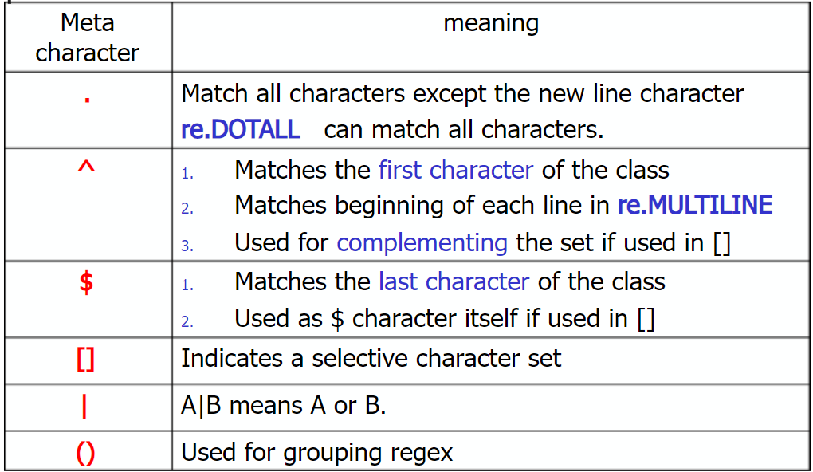
some commonly used metacharacters and their meanings:

Slide 5
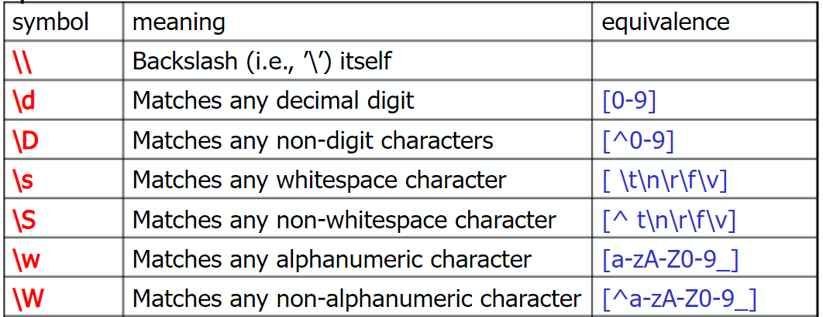
some commonly used metacharacters and their meanings:

Slide 6
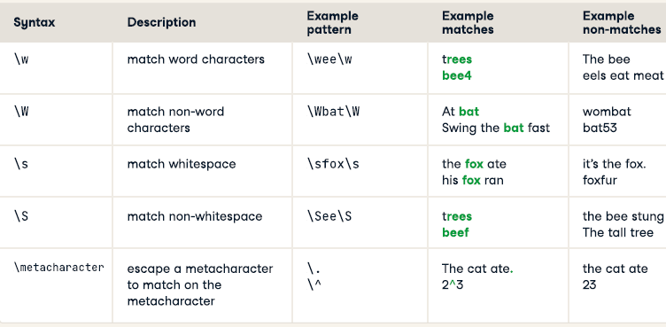
some commonly used metacharacters and their meanings:

Slide 7
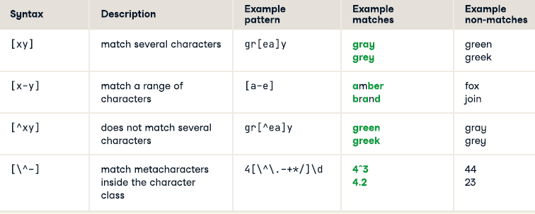
some commonly used metacharacters and their meanings:

Slide 8
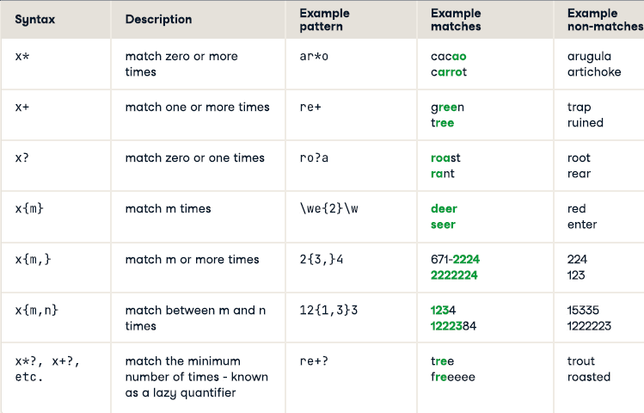
some commonly used metacharacters and their meanings:

Slide 9
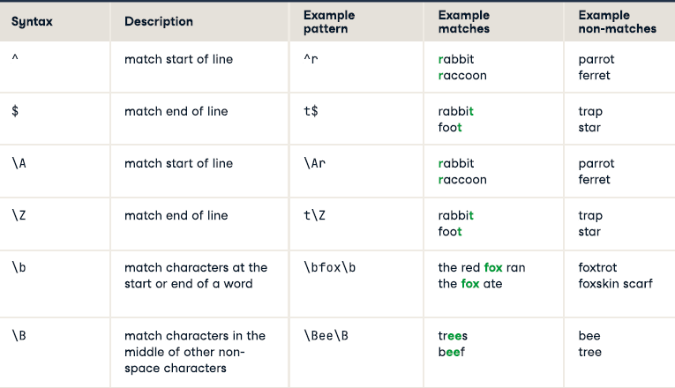
some commonly used metacharacters and their meanings:

Slide 10
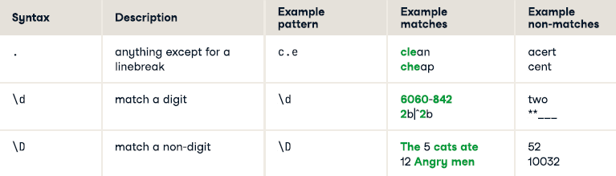
some commonly used metacharacters and their meanings:

Slide 11

Test Regular Expersion
To test a pattern against a string in JavaScript, you can use the test() method of the RegExp object. It returns true if the pattern matches any part of the string, and false otherwise.

Slide 12
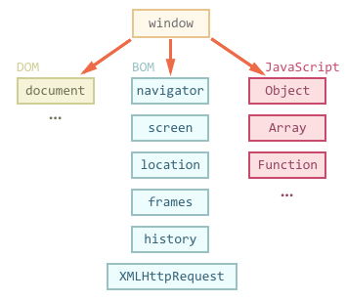
The Browser Object Model (BOM)
BOM, which stands for Browser Object Model, is a set of JavaScript APIs that provides interaction and control over the web browser. The BOM represents the browser window and its components, such as the location bar, history, and other browser-related functionalities. It is an extension of the core JavaScript language and allows developers to manipulate and access various aspects of the browser environment.

Slide 13
Features of the BOM
1- Window Object: The window object represents the browser window or tab and serves as the global object for JavaScript in the browser environment. It provides access to various properties and methods related to the browser window, such as controlling window size, opening new windows or tabs, and managing the browser's history.
Two properties can be used to determine the size of the browser window.
Both properties return the sizes in pixels:
window.innerHeight - the inner height of the browser window (in pixels)
window.innerWidth - the inner width of the browser window (in pixels)
Some other methods:
window.open(url, target, features): Opens a new browser window or tab with the specified URL and optional target and features.)
window.close() - close the current window

Slide 14
Features of the BOM
2-Document Object: The document object represents the web page loaded in the browser window. It provides access to the HTML elements and enables manipulation of the document's structure, content, and styles. Developers can use the document object to modify page elements, retrieve and update data, and handle events.

Slide 15
Features of the BOM
3-Location Object: The location object represents the URL of the current web page loaded in the browser window. It provides properties to access and manipulate different parts of the URL, such as the protocol, hostname, path, query parameters, and more. Developers can use the location object to redirect the browser to a new URL or extract information from the current URL.
Location Object Properties:
location.href: The complete URL of the current page.
location.search: The query string (e.g., "?key=value") of the current URL.
location.hash: The fragment identifier (e.g., "#section") of the current URL.
Location Object Methods:
location.assign(url): Loads the specified URL.
location.replace(url): Replaces the current URL with the specified URL, without adding it to the browser's history.
location.reload(): Reloads the current page.

Slide 16
Features of the BOM
4-Navigator Object: The navigator object provides information about the web browser such as its name, version, platform, and user agent string. It also provides access to properties and methods related to browser features, such as geolocation, cookies, and browser plugins. Developers can use the navigator object to detect specific browser capabilities and adjust their code accordingly.
Navigator Object Properties:
navigator.userAgent: Returns the user agent string of the browser.
navigator.language: Returns the preferred language of the user.
navigator.cookieEnabled: Indicates whether cookies are enabled in the browser.
navigator.geolocation: Provides access to the Geolocation API for retrieving the user's location.
navigator.plugins: Returns an array of Plugin objects representing the browser plugins installed.
Navigator Object Methods:
navigator.geolocation.getCurrentPosition()

Slide 17
Features of the BOM
5-History Object: The history object represents the browser's session history, including the URLs visited by the user in the current tab or window. It allows developers to navigate back and forth through the user's browsing history programmatically.
History Object Properties:
history.length: Returns the number of URLs in the session history of the current tab.
history.state: Returns the state object associated with the current URL.
History Object Methods:
history.back(): Navigates to the previous URL in the session history.
history.forward(): Navigates to the next URL in the session history.
history.go(n): Navigates to an URL relative to the current position in the session history. Positive n values go forward, and negative n values go back.

Slide 18
Features of the BOM
6-Timers: The BOM provides functions for scheduling and executing code at specific intervals using timers. The setTimeout() function and setInterval() function are commonly used to execute code after a specified delay or repeatedly at a defined interval.
Timer Methods:
setInterval(function, milliseconds): Executes the callback function repeatedly with the specified delay (in milliseconds) between each execution and returns a timer ID.
clearInterval(intervalId): Stops the repeated execution of the callback specified by the timer ID.
setTimeout(callback, delay): Executes the callback function after the specified delay (in milliseconds) and returns a timer ID.
clearTimeout(timeoutId): Cancels the timeout specified by the timer ID, preventing the callback from being executed.

Slide 19
Features of the BOM
7-Dialogs: The BOM includes methods to display dialogs or prompts to the user, such as the alert(), confirm(), and prompt() functions. These functions allow developers to show messages, confirm user actions, or obtain user input within the browser window.

Slide 20
Features of the BOM
8-Screen: Window Screen
The window.screen object can be written without the window prefix.
Properties:
screen.width : property returns the width of the visitor's screen in pixels.
screen.height : property returns the height of the visitor's screen in pixels.
screen.availWidth : property returns the width of the visitor's screen, in pixels, minus interface features like the Windows Taskbar.
screen.availHeight : property returns the height of the visitor's screen, in pixels, minus interface features like the Windows Taskbar.

Slide 21
Thanks!
Do you have any questions?
asmaaahmed23762@gmail.com

